Slide 2
You have:
149,209 rows
54,170 unique safetyreportid
Therefore, many safety reports have more than one row.
1. Why are there more rows than safety reports?
Your dataset contains the reaction variable. A single safety report can contain multiple adverse reactions.
For example:
This is not necessarily duplicate data.
It means:
One safety report → potentially multiple reaction records.
So do not remove these rows with drop_duplicates().
safetyreportid | generic_name | reaction
10001 | semaglutide | nausea
10001 | semaglutide | vomiting
10001 | semaglutide | abdominal pain

Slide 3
RQ1 — Safety
How do adverse-event profiles differ among GLP-1 drugs?
RQ2 — Patient characteristics
How are age, sex, weight, and serious outcomes associated with reported adverse events?
RQ3 — Time and market
How do adverse-event reporting trends change over time, and how do they relate temporally to manufacturer stock-price trends?

Slide 4
How do adverse-event patterns differ across GLP-1 drugs, and what demographic and clinical factors are associated with serious adverse events?

Slide 5
Question 1 — Drug safety profile
How do serious adverse-event rates differ between GLP-1 drugs?
Variables:
generic_name
brand_queried
serious
seriousness_hospitalization
seriousness_death
seriousness_lifethreatening
seriousness_disabling

Slide 6
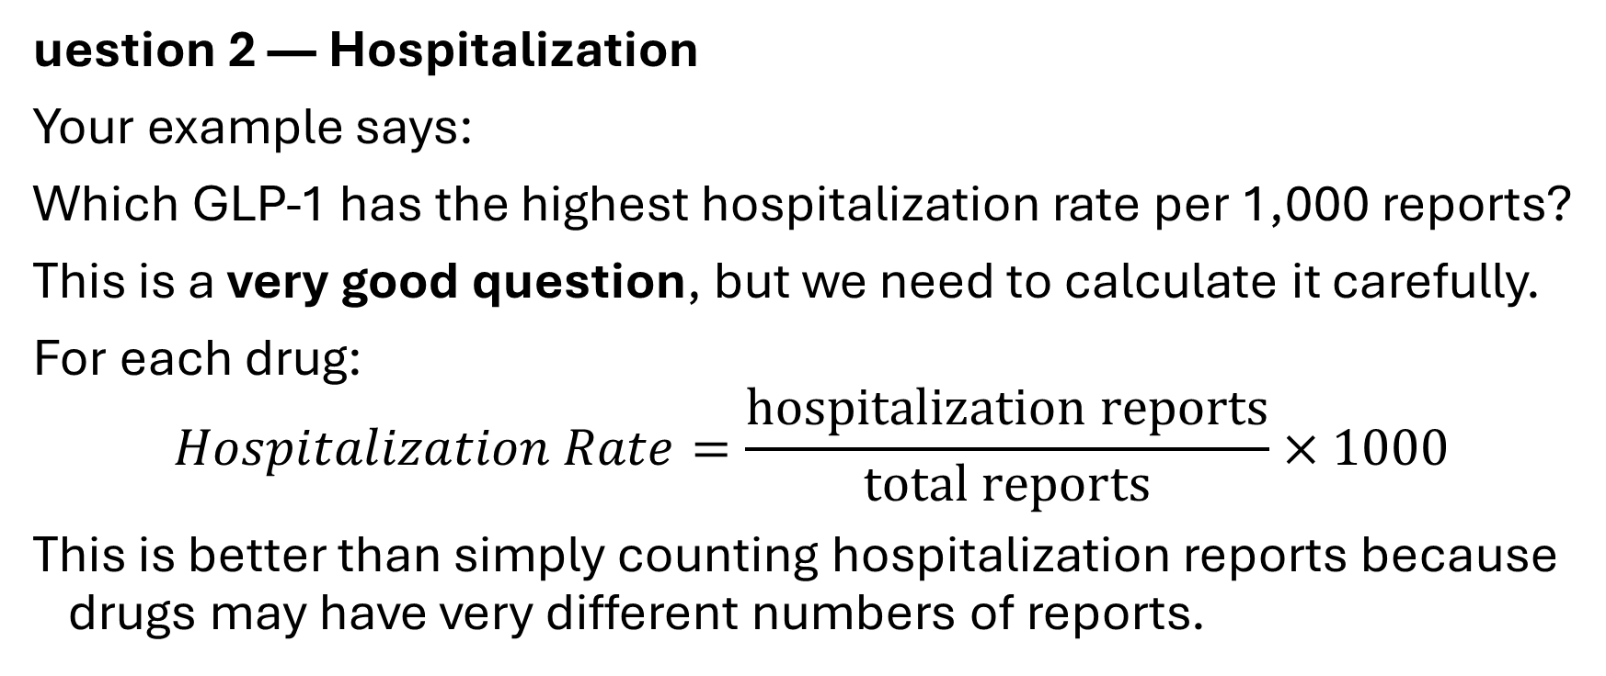
uestion 2 — Hospitalization
Your example says:
Which GLP-1 has the highest hospitalization rate per 1,000 reports?
This is a very good question, but we need to calculate it carefully.
For each drug:
$$Hospitalization Rate=\frac{\text{hospitalization reports}}{\text{total reports}}×1000$$
This is better than simply counting hospitalization reports because drugs may have very different numbers of reports.

Slide 7
Question 3 — Demographics
We have:
patient_age
patient_sex
patient_weight_kg
So we can ask:
How do patient demographics vary across GLP-1 drugs and serious adverse events?
This satisfies an important part of your rubric because the rubric explicitly requires investigation of at least six variables using both univariate and bi/multivariate analysis.

Slide 8
Question 4 — Adverse reactions
We have:
reaction
reaction_outcome
This gives us a very interesting direction:
Which adverse reactions are most frequently reported for each GLP-1 drug, and are particular reactions associated with serious outcomes?
For example, we could eventually investigate:
Drug
↓
Reaction
↓
Serious / non-serious
↓
Outcome
This could become one of the strongest parts of the EDA.

Slide 9
Question 5 — Time
We have:
receive_date
So we can investigate:
How have adverse-event reports changed over time for different GLP-1 drugs?

